Slide 1
The Analytics Journey A Marketing Example
Bobby Caudill Director, Field Marketing Content Strategy Informatica
Notes:
There is a lot of business interest in analytics and data lakes.
We will talk about the analytics “journey” from the Data Warehouse to the Data Lake and cloud, using a Marketing Data Lake as an example.
In fact, marketing is where we are seeing a lot of the customer interest today.
AUDIENCE: This was written for a typical Informatica World Audience 30% Sr. IT, 40% Developers, 25% Business, 5% other
This presentation talks more towards Sr. IT, and Business Leaders

Slide 2
The rise of the Digital Economy
Notes:
it’s a digital world.
Last tech shift was Internet/ebusiness: Amazon disrupted first, book retailers - then all retailers
Causation – Correlation
Pervasive technology - Mobile, cloud and IoT
Customer experience
New ways to conduct business

Slide 3
Customer experience
Notes:
My ex wife is a shopper, a very loyal Nordy customer - Boots
to do one thing well: serve our customer in an exceptional way.
100 years worth of customer data!
20 different systems
connecting those customers dots to understand
household.
And that 360 degree view
10 years they have consistently out-performed the SP 500 index and added strong growth.

Slide 4
Disrupting industries
Notes:
smaller than other hotel chais and then there is new competition from others like AirBnB.
not good enough to compete on the physical room.
customer experience and creating emotional ties
results.
YOY Revenue increase from Upsell/Promo offers.
reduce cost for Loyalty Program global promotions by 50%.
YOY Increase in Key customer service metrics

Slide 5
Data is the product
Notes:
GE becoming a digital industrial company.
aircraft with a GE engine takes off somewhere in the world Every two seconds.
killer for this 124 year old company is predictive maintenance.
can shift physical engines or machines to digital services
they capture the streaming data generated by the sensors on the engines.
Today, “the game is about creating the most efficiency around an asset--a machine, a factory, etc.”
By owning the Software for its products, the software becomes how value is derived for an asset.

Slide 6
But CMOs do not want to be CIOs
Notes:
But, CMOs are finding out that the data complexities are far worse than they imagined. And buying more stand-alone applications only makes the data fragmentation problem worse.
Result: Spending on departmental projects that are unconnected from IT or the rest of the organization are being brought back in.
CMOs are working closely with their IT counterparts – actually the smart CMOs always have!

Slide 7
The CMO View
“IT is just too slow to deliver the data.”
“Everything in Marketing has analytics.”
“Sometimes fast is more important than perfect.”
“Data is our competitive advantage!”
“Marketing needs data self-service to succeed!”
Notes:
CMO or VP of Marketing Operations
Your job is to use analytics to deliver business value. Depending on your function, that could be analytics initiatives such as (emphasize the ones that fit your customer)
Increase customer upsell & cross-sell (Marketing)
Improved sales efficiency. Intelligent recommendations for “Next best step” with a customer (Sales)
Real time data updates and analytics for decision making (Executive and Operations)
Fraud detection. Looking for patterns of behavior that would suggest fraud. (Financial Services)
Improved customer interactions and customer loyalty (Customer Service)
Reduced customer churn or Lost customer win-back analysis (Telco, Cloud Companies)
The point is that most new business initiatives in the digital world depend on analytics, and clean, complete and timely data to fuel those analytics. The problem is SPEED. It simply takes too long to get the data you need whether that data is provided by IT or prepared by LOB business analysts.
It is getting to the point where some LOB Leaders think they need to work around IT to get the job done fast enough to meet their business objectives.

Slide 8
The CIO View
“Big Data is interesting, but we need to show business value to Marketing.”
“Need to enable Marketing to self-serve data.”
“I need technology that can scale, not one-offs!”
“Need to deliver new data at the pace & quality that Marketing requires.”
“My Data Warehouse is rock solid, but inflexible and costly for new Marketing requirements.”
Notes:
CIO View
On the IT side, the struggle is to deliver the data the business requires in the timeframe and quality levels that the business requires.
But, decades of managing data as an afterthought has left an enormous data management challenge (see next slide)

Slide 9
"The need for increased agility and accessibility for data analysis is the primary driver for data lakes."
Andrew White -
Notes:
What is driving the need data lakes? Gartner quote.
Agility – a lot of data lakes is more about many kinds of data rather than huge data sets.
Accessibility for business self-service
This is especially true in marketing which is becoming very data-driven.

Slide 10
Informatica’s Marketing Transformation
Notes:
12:30 – 12:45 PM
Introductions and goals for today
Interactive discussions
Capture insight and needs
Attendee & speaker introductions
60 second intro, and at same time let’s dive straight into our topic of data.
Please introduce yourself and tell us briefly about what you do and what the role of data is in your work.
12:45– 1:15 PM
30 Minutes
Perspectives Discussion: Every Great Marketing Strategy Needs a Great Data Strategy - Why, What, Where?
Proficiency Assessment
1:15 – 1:25 PM
10 minutes
Informatica Marketing Data Lake
Case study to show how Marketers can strategically use data to understand buying behaviors and shrink the window from lead to revenue
1:25 – 1:35 PM
10 minutes
Customer Story
Real-world case study showcasing how a customer is using Informatica technology to drive great marketing strategies across their organization
1:35 – 2:20 PM
45 Minutes
Interactive Discussion
Q&A for Attendees:
ou make in the coming year?
2:20-2:30 PM
10 Minutes
Closing Comments
Summary comments, based on discussion
Point to online resources, discussion groups, etc.
Depart promptly by 2:30 PM

Slide 11
Predict Outcomes
Close the Gap from Lead to Revenue
Grow
Opportunity
The colors will need to line up with the other slide. Kim wanted to remove the earlier build with the dots moving around. I modified so that the dots are simplified to show them working to grow and anticipate opportunity but they don’t move around. You can adjust the builds / dots as necessary. For instance, the dots can build in a little faster and some need to be repositioned slightly. Perhaps add other dots with the different colors to represent the colors on the other slide. She just doesn’t want it to be too busy.

Slide 12
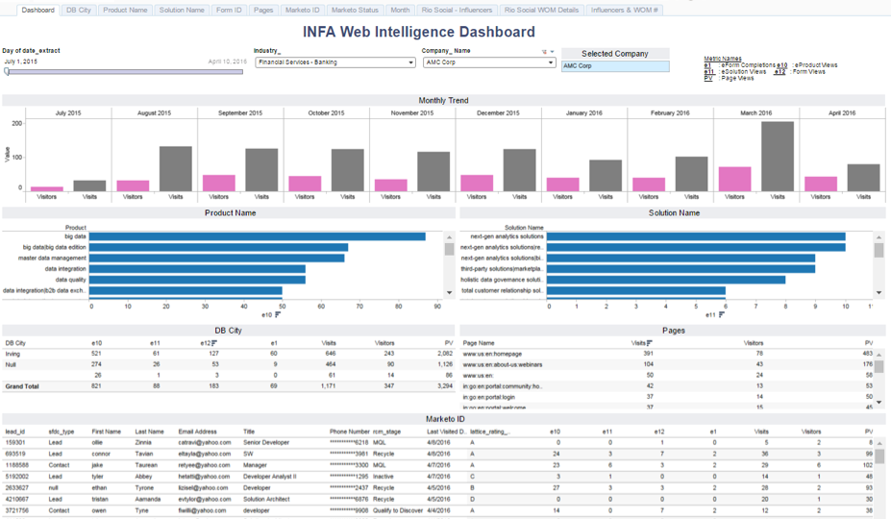
See which accounts are visiting
Know how often
Understand which assets
were consumed
Identify the buying team

Slide 13
Thank You!

